Slide 1

JP COLLEGE OF ENGINEERING College Road,Ayikudi,Tenkasi-627852 Affiliated to Anna University and Approved by AICTE
Smart Waste Management System for metropolitan cities
Team ID:PNT2022TMID50056
Industry Mentor : Mr. DINESH
Faculty Mentor : Mr. PARAMAIYAPPAN. M
Team Lead : R. GEORGE DENIFER,
B.DANIEL,
M.GURU PRASATH,
R.SURESH.

Slide 2
AGENDA
Introduction
Problem Statement
Ideation & Proposed Solution
Data Flow Diagram
Solution Architecture
Functional Requirement
Advantages
Disadvantages
Demo Video
Future Scope

Slide 3
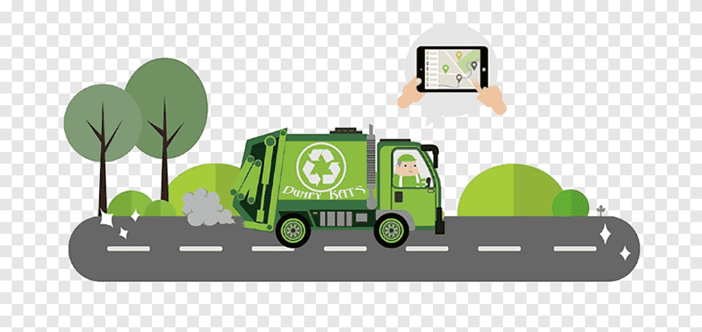
INTRODUCTION
The project is based on the concept of Automation used in waste management system under the domain of Cleanliness and Hygiene. Dumping garbage onto the streets and in public areas is a common synopsis found in all developing countries and this mainly end up affecting the environment and creating several unhygienic conditions. is a combination of hardware and software technologies i.e. connecting Wi-Fi system to the normal dustbin in order to provide free internet facilities to the user for a particular period of time. The technology awards the user for keeping the surrounding clean and thus work hand in hand for the proper waste management in a locality. Smart netbin uses multiple technologies firstly the technology for measuring the amount of trash dumped secondly the movement of the waste and lastly sending necessary signals and connecting the user tothe Wi- Fi system.

Slide 4
PROBLEM STATEMENT
Waste Generation Solid waste generation rates estimate the amount of waste created by residences or businesses over a certain amount of time (day, year, etc.). Waste generation includes all materials discarded, whether or not they are later recycled or disposed in a landfill.

Slide 5
PROPOSED SOLUTION
To maintain waste in the metropolitan cities and to maintain the clean environment which is polluted by the wastes and to dispose wastes.
-Software can be implemented,
-Fine can be implemented,
-Create awareness.
This system provides awareness among the people and safeguard the environment with the help of people.
Clean cities Healthy environment Peaceful life. To help government to maintain clean environment.
-Offering software as a service model to government,
-Making use of useful wastes and making it us money.

Slide 6
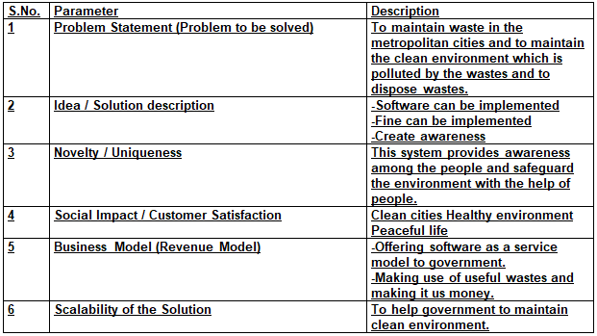
PROPOSED SOLUTION

Slide 7
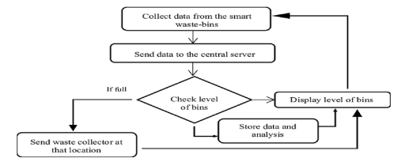
DATA FLOW DIAGRAM
A data ﬂow diagram (DFD) is a graphical or visual representation using a standardized set of symbols and notations to describe a business's operations through data movement

Slide 8
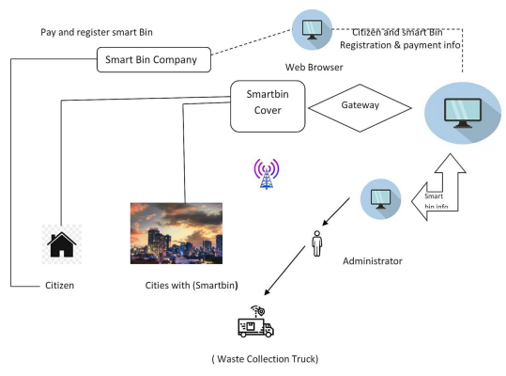
SOLUTION ARCHITECTURE
A solutions architect creates the overall technical vision for a speciﬁc solution to a business problem

Slide 9
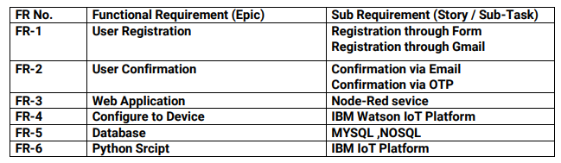
FUNCTIONAL REQUIREMENT
Functional requirements are product features or functions that developers must implement to enable users to accomplish their tasks

Slide 10
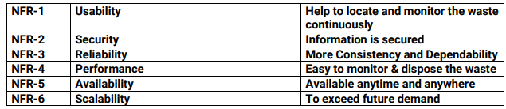
NON FUNCTIONAL REQUIREMENT
Non-functional requirements or NFRs are a set of speciﬁcations that describe the system's operation capabilities and constraints and attempt to improve its functionality.

Slide 11
ADVANTAGES
Know the current location:
-Our Kids GPS Tracker provides real-time location of your Dustbin.
Emergency call:
-Our GPS trackers have an emergency call button. ISmart netbin uses multiple technologies firstly the technology for measuring the amount of trash dumped secondly the movement of the waste and lastly sending necessary signals and connecting the user to the button to connect to you.
Alerts:
-Both the Monitering system and municipality or area administration authorities can receive alerts, notiﬁcations or messages about The threshold level levels of the bin are indicated my multiple sensors attached to bin.
Track Garbag Location:
-The area in which garbage is found to overflow is allocated to respective garbage collectors in the form of messages through GSM system. Once the waste bin is emptied, an information update is sent to the municipality and server is updated.

Slide 12
DISADVANTAGES
System requires a greater number of waste bins for separate waste collection as perpopulation in the city.
This results into high initial cost due to expensive smart dustbins compare to othermethods. Sensor nodes used in the dustbins have limited memory size.

Slide 13
DEMO VIDEO
Demo Video link:
https://drive.google.com/file/d/17pSCK7sMBAAA869jU-YrIfaqVKxE2fW_/view?usp=share_link

Slide 14
FUTURE SCOPE
Change the system of user authentication and atomic lock of bins, which would aid inprotecting the bin from damage or theft.
The concept of green points would encourage the involvement of residents or end users,making the idea successful and aiding in the achievement of collaborative wastemanagement efforts, thus fulfilling the idea of Swachh Bharath.
Having case study or data analytics on the type and times waste is collected on differentdays or seasons, making bin filling predictable and removing the reliance on electroniccomponents, and fixing the coordinates.
Improving the Server's and Android's graphical interfaces

Slide 15


